Slide 1
Leadership and the One Minute Manager
By: Tanner Gibson

Slide 2
About Ken Blanchard
Born on May 6, 1939 in Orange, New Jersey
Degrees:
BA in government and philosophy
MA in sociology and counseling
PhD in education administration and leadership
He also writes all of the One Minute Manager books

Slide 3
Directive Behavior
Involves:
Clearly telling people what to do
How to do it
When to do it
Then, closely monitoring their performance

Slide 4
Supportive Behavior
Involves:
Listening to people
Providing support and encouragement for their efforts
Then, facilitating their involvement in problem-solving and decision-making

Slide 5
Leadership Style 1 Directing
The leader provides specific direction and closely monitors task accomplishment
Best for people who are enthusiastic beginners
High directive and low supportive behavior

Slide 6
Leadership Style 2 Coaching
The leader continues to direct and closely monitor task accomplishment, but also explains decisions, solicits suggestions, and supports progress
Best for disillusioned learners
High directive and high supportive behavior

Slide 7
Leadership Style 3 Supporting
The leader facilitates and supports people’s efforts toward task accomplishment and shares responsibility for decision-making with them
Best for experienced and competent people who are sometimes reluctant or cautious contributors
High supportive and low directive behavior

Slide 8
Leadership Style 4 Delegating
The leader turns over responsibility for decision-making and problem-solving to people
Best for people who are self-reliant achievers
Low supportive and low directive behavior

Slide 9
Competence
One of the two factors that determine a person’s performance or achievement
Competence is a function of knowledge and skills
Gained from education, training, and/or experience

Slide 10
Commitment
The other of the two factors that determine a person’s performance or achievement
Commitment is a combination of confidence and motivation
Confidence is a measure of a person’s self assuredness
Motivation is a person’s interest and enthusiasm for doing a task well

Slide 11
Development Levels
D1
Low competence and high commitment
They need direction and frequent feedback to get them started
D2
Some to low competence and low commitment
They need direction and feedback
They also need support and praise to build their self esteem

Slide 12
Development Levels cont.
D3
Moderate to high competence and variable commitment
They do not need much direction but they do need support to get their confidence and motivation
D4
High competence and high commitment
They are able and willing to do projects alone

Slide 13
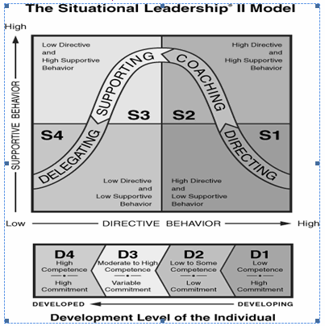
Shows relation between leadership style and development level

Slide 14
In ORGB
The ORGB textbook actually uses Ken Blanchard’s Situational Leadership model

Slide 15
Summary
There are two different leadership behaviors: directive and supportive
There are four leadership styles: directing, coaching, supporting, and delegating
There are two factors that determine a person’s performance or achievement: competence and commitment

Slide 16
Summary cont.
Then, there are four development levels to show their level of competence and commitment

